Slide 1
Sensitive Data Security for Consumers
May 2022
Notes:
Today we want to share with you a product idea that some of us at San Jose office have been working on for protecting personal data, especially those that can be stolen and used by the bad guys to carry out financial frauds and crimes.
The idea (kind of) came about because one of the San Jose colleagues mentioned that he’s been using an open source, offline password manager tool because he’s so worried about increasing the chance his personal information, credentials, and accounts would be compromised if he were to keep such information online. That initial conversation led to other discussions about how different people store and protect their most sensitive information. Some people are so worried that they would only document their most sensitive information on a piece of paper, while others resort to less drastic approaches.

Slide 2
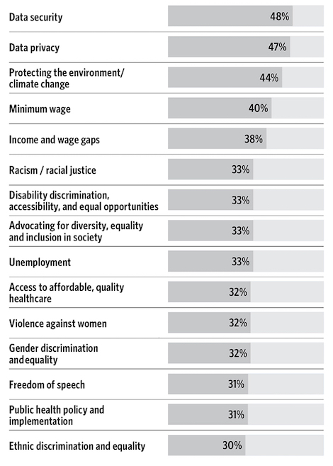

Security of Data Remains Top Consumer Concern
Notes:
I guess it shouldn’t be a big surprise that data security and closely related, data privacy, continue to be top concerns for consumers in 2022, according to many studies and surveys. One study done by Fleishman Hillard indicates that data security actually tops other issues like climate change, income and jobs, and racism as top-of-mind issues for many consumers.

Slide 3
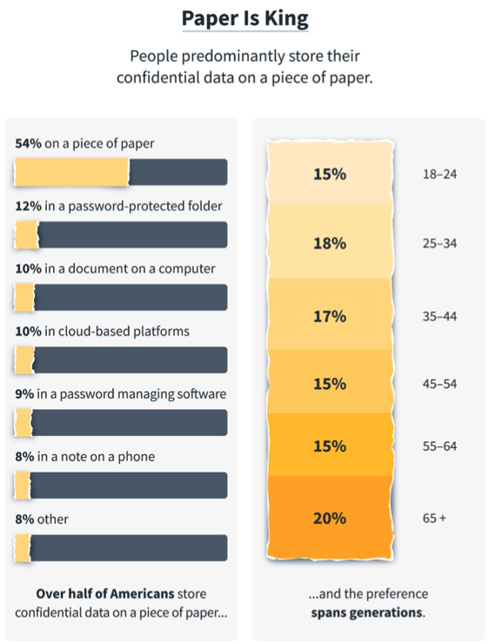
There Is Awareness and Worry…
According to a 2021 study, 54% of people store their confidential data on a piece of paper.
Some conclusions:
People worry about security of their most sensitive data
People recognize or perceive the computer and cloud to be susceptible to cyber attacks and unsafe for storing sensitive data

Slide 4
Rapid Growth of ID & Data Protection Solutions
Consumer Security
Device Security
Network Security
ID Related Services
Data Security
Antivirus ($1.8B USD US TAM, Flat growth)
Data Encryption
Secure Data Storage
Password Mgmt ($900M USD 2020 global TAM, 20% CAGR)
Home Network Security
VPN/WiFi Security
ID Recovery Service ($10B USD 2022 global TAM, 9.4% CAGR)
Data Broker Removal Service
https://www.consumer.ftc.gov/articles/protect-your-personal-information-and-data
Notes:
Indeed when you look at the consumer security market, those products and services that cater to protecting people’s data, their credentials and online accounts, and services that help consumers protect or restore their financial identities have all done very well lately—and have been growing pretty fast relative to the rest of, the more traditional security market of protecting their devices.
Vendors are putting a lot of money into the market in terms of educating and influencing the consumers, and people are opening their pocket books and paying for these solutions.

Slide 5
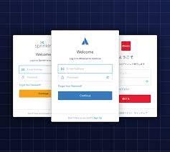
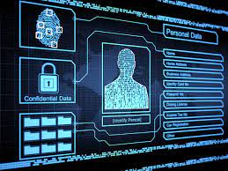
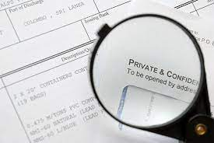
Much Data to be Secured (or be Stolen)
Account credentials
Usernames, passwords, login security questions & answers, etc.
Personal information
Home addresses, email addresses, phone #’s, SSNs, birthdays, DLs, mother’s maiden name, medical records, etc.
Documents
Tax returns, credit card statements, etc.
Notes:
With all the online crimes being committed today, people are concerned. There are simply a lot of data that consumers have that, if not properly protected, could be used by criminals to carry out unauthorized financial transactions.
There are obviously the usernames and passwords—the account credentials, those login security questions and answers—especially ones for our financial accounts—that need to be protected, but that’s just a part of it.
We also need to make sure bad guys don’t have access to our SSNs date of birthday, driver’s license info, healthcare records, home addresses, and so forth—because the more information they get their hands on, the more likely they will be able to impersonate us and conduct authorized transactions.
The more people can do to secure and protect their data—the so called PII data—the less likely they will be victims.

Slide 6
Our Solution
Notes:
With that as background, I want to talk about what solution we’re proposing here.

Slide 7
Personal Data Security
An easy way to organize & secure your personal data
Notes:
At a high level, we believe there is demand for hassle-free solutions that help consumers easily organize and secure their most critical personal data, especially those that can be used for carrying out financial frauds.

Slide 8
Ideal Personal Data Lifecycle
User receives an email, or downloads a document containing sensitive data
User views the info, and acts on the info as needed
Data is removed or secured (encrypted, moved to secure location, etc.)
NOT happening consistently enough
Notes:
Consider the following data lifecycle…
I think this is a pretty simple representation of what most people do on a daily basis.
We receive emails, or we might download documents containing some personal or sensitive information to our PC or laptop from time to time. It could be the most recent credit card statement, or maybe it’s beginning of the year, and we are downloading in the US tax documents like the 1099 statements, for example.
Once copies of these documents are downloaded, we will often just take a quick look at them, which is the case for credit card statements—or do something with the information provided by the documents.
In an ideal world, at least from security perspective, once we are done with the credit card statement or the tax document, we would either delete the document right away, or at least secure the document somehow—either by encrypting the document, or by moving the document to a more secure folder.
<click>
But in reality, this doesn’t happen enough—this last step of securing the document. And there are different reasons for it not happening consistently:
1. People just forget to do it
2. We don’t know we have documents with sensitive PII on their computer—or maybe we just don’t know where they are sometimes.
3. Lastly, sometimes it’s just too much hassle involved in finding those documents and taking the time to delete or secure them.

Slide 9
Critical Solution Designs
Smart
Intelligent identification of PII data
Secure
Option to store data off-line, 2FA/MFA support, etc.
Easy to Use
Automation & “1-Click” securing of data
Remove unnecessary data from insecure places
Notes:
So what we’re proposing here is creating a solution to help people secure their data. For people to want to use this solution, we think this solution needs to be easy to use to the point that it doesn’t interfere with how people use the information, and what they do with the documents.
First of all, the identification of what’s sensitive data versus what’s not needs to be smart and accurate enough, for starter. You don’t want the user to have to intervene and override all the time, and be involved in too much manual work dealing with FPs and FNs.
Secondly, once the solution has identified documents or data with sensitive personal info, the solution also needs to support how people want to secure their data. For some people, maybe they want to store the data offline on a USB stick. For others, maybe they don’t need to have a local backup copy and just want the document or data deleted automatically all the time—AFTER they are done viewing the document. For some other people, maybe they want the document to be automatically relocated to their Personal Vault on one of the cloud storage drives when they are done viewing the document.
Whatever it maybe, the key thing is the solution needs to be very easy to use, and almost invisibile, for it to be useful.

Slide 10
Complements Other Security Solutions
Antivirus
Detects, prevents, and removes malwares on devices, including data-stealing programs
Password Managers
Store secure passwords securely
Secure Storage
USB stick, SAN, Cloud storage with 2FA-protected “data vault” folders, etc.
Offers convenience and ease of security
Notes:
I do have a simple demo I want to show, but before we get to the demo…..
I do think this type of solution would complement other popular security solutions on the market that people are using today.
We know antivirus solutions do a great job of detecting and removing malwares, and malicious programs on people’s PCs and laptops, password managers do a fantastic job of helping you to secure those online accounts by making it easy for people to use secure passwords, and many cloud storage vendors have come out with the so-called personal vault or data vault to provide additional security for people’s most sensitive data.
But as far as we know, we don’t believe there are solutions out there that do a decent job of identify your sensitive PII data and document, and help you remove or secure those data, so they don’t, for whatever reasons, end up in the wrong hands of criminals.

Slide 11
DEMO

Slide 12
Demo Scenario
User downloads a tax document to laptop.
App detects the document containing the user’s SSN lying around in his Downloads folder.
At an appropriate time, application notifies and recommends the user to take some action to secure the document.
User secures the data by deleting the document or relocating it to a secure folder.

Slide 13
Execution Plan

Slide 14
We Believe….
There is unmet demand for a easy to use solution for securing people’s most valuable and critical personal and financial data (such as credentials to critical financial accounts, SSN, tax returns, etc.)
Unmet demand exists for efficient tool to secure and/or remove sensitive personal and financial data from PCs and laptops.
At least 1/5 of users who pay for non-1st party password manager solutions would be interested and pay for our solution.

Slide 15
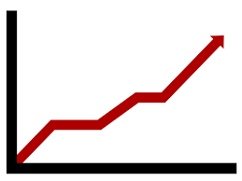



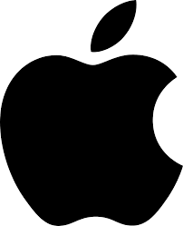
Consumers Are Willing to Pay
Advanced Encryption
2FA/MFA Support
Breach Notification
Cross Ecosystem Support
Data Self Storage Capability
Password management market:
2020: 900M (40M+ users)
2025: 2B
CAGR: ~20%
Password Vault
Password Generator
Basic Encryption
Autofill
Breach Detection

Slide 16
Estimated Total Addressable Market (Global)
Based on 2020 password manager $900M market size, 40M users paying $22 USD/user/year
In 2025, projected $2B market size at $22 USD/user ➔ 90M users
90M users X 20% = 18M users potentially interested in our solution in 2025
Assuming $20/user/year ➔ $360M USD TAM

Slide 17
Why Trend
Trend lacking a clearly positioned personal data security solution today
Existing Trend know-hows and technologies can be leveraged
No one offers strong personal data security solution today

Slide 18
Trend Micro ID Protection Solution
Personalization & Automation
Password Management
Document Security
Social Media Security
Breach Notification
PII Data
Secure Erase
Advanced Encryption
2FA/MFA Support
Secure Storage
Consumer “DLP” Engine
Website/Domain
Categorization Engine
Homomorphic Encryption
String/Pattern/Fuzzy Matching Algorithms

Slide 19
Bootstrap Roadmap
Confirm Demand
Publish blog to gauge interest in solution
Confirm unmet need in securing personal data on PCs/laptops
Build MVP
MVP to (1) identify sensitive data based on SSN, etc. for PCs/laptops; (2) 1-click cleanup
Confirm value and grow adoption
Enhance
Add features to eliminate usage frictions and secure data
Monitor use of initial enhancement in selective user segments

